Slide 1
My Perimeter, Area and Volume Interactive Notebook
Name
Class
Term 3 Semester 2

Slide 2
Contents
Formula Page
Page
Date
Description
2
3

Slide 3
Tasks
24
7
30
Essential Question
Questions
Notes
Summary
24
25

Slide 4
24
7
30
Date
Surface Area of a Cylinder
EQ – Describe the process for finding the TSA of a cylinder.
25

Slide 5
What 2 shapes are required to make a cylinder?

Slide 6
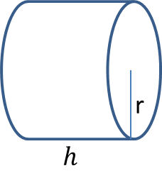
24
7
30
Date
Surface Area of a Cylinder
EQ – Describe the process for finding the TSA of a cylinder.
The cylinder is formed from two circles and one rectangle
25

Slide 7


24
7
30
Date
Surface Area of a Cylinder
EQ – Describe the process for finding the TSA of a cylinder.
The cylinder is formed from two circles and one rectangle
What does the net of a cylinder look like?
r
r
$$h$$
$$h$$
r
25

Slide 8


24
7
30
Date
Surface Area of a Cylinder
EQ – Describe the process for finding the TSA of a cylinder.
The cylinder is formed from two circles and one rectangle
$$Area=$$
$$h$$
25

Slide 9

24
7
30
Date
Surface Area of a Cylinder
EQ – Describe the process for finding the TSA of a cylinder.
The cylinder is formed from two circles and one rectangle
$$Area=πr^{2}$$
$$h$$
25

Slide 10


24
7
30
Date
Surface Area of a Cylinder
EQ – Describe the process for finding the TSA of a cylinder.
The cylinder is formed from two circles and one rectangle
Same length as the circumference of the circle
$$2πr$$
$$Area=πr^{2}$$
$$h$$
25

Slide 11
24
7
30
Date
Surface Area of a Cylinder
EQ – Describe the process for finding the TSA of a cylinder.
The cylinder is formed from two circles and one rectangle
Same length as the circumference of the circle
$$2πr$$
$$Area=πr^{2}$$
$$h$$
TSA = 2 circles + 1 rectangle
=
25

Slide 12
How do we find the SA of a Cylinder?

Slide 13
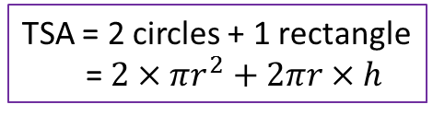
24
7
30
Date
Surface Area of a Cylinder
EQ – Describe the process for finding the TSA of a cylinder.
The cylinder is formed from two circles and one rectangle
Same length as the circumference of the circle
$$2πr$$
$$Area=πr^{2}$$
$$h$$
TSA = 2 circles + 1 rectangle
= $2×πr^{2}+2πr×h$
25

Slide 14
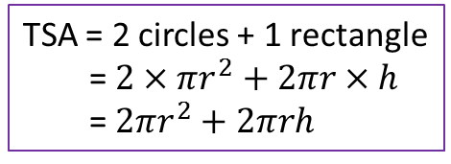
24
7
30
Date
Surface Area of a Cylinder
EQ – Describe the process for finding the TSA of a cylinder.
The cylinder is formed from two circles and one rectangle
Same length as the circumference of the circle
$$2πr$$
$$Area=πr^{2}$$
$$h$$
TSA = 2 circles + 1 rectangle
= $2×πr^{2}+2πr×h$
= $2πr^{2}+2πrh$
25

Slide 15
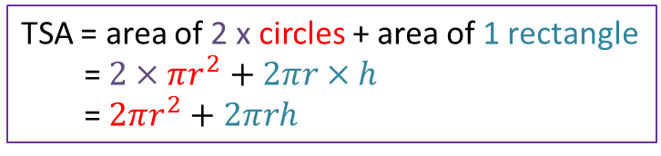
24
7
30
Date
Surface Area of a Cylinder
EQ – Describe the process for finding the TSA of a cylinder.
What is the net made up of?
The cylinder is formed from two circles and one rectangle
Same length as the circumference of the circle
We only need the radius and the height to calculate the SA of a cylinder
$$2πr$$
$$Area=πr^{2}$$
$$h$$
How do I find the Surface Area?
TSA = area of 2 x circles + area of 1 rectangle
= $2×πr^{2}+2πr×h$
= $2πr^{2}+2πrh$
25

Slide 16


24
7
30
Date
Volume of a Prism
EQ – Describe how the formula for the area of a circle is used to find the volume of a cylinder?
TSA = $2πr^{2}+2πrh$
r
$$h$$
5cm
6cm
19

Slide 17
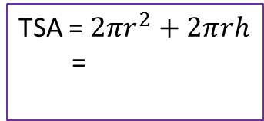
24
7
30
Date
Volume of a Prism
EQ – Describe how the formula for the area of a circle is used to find the volume of a cylinder?
TSA = $2πr^{2}+2πrh$
r
$$h$$
5cm
TSA = $2πr^{2}+2πrh$
=
6cm
19

Slide 18
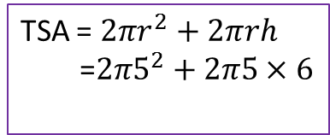
24
7
30
Date
Volume of a Prism
EQ – Describe how the formula for the area of a circle is used to find the volume of a cylinder?
TSA = $2πr^{2}+2πrh$
r
$$h$$
5cm
TSA = $2πr^{2}+2πrh$
=$2π5^{2}+2π5×6$
6cm
19

Slide 19
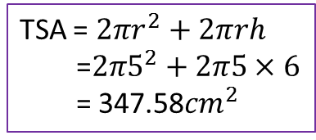
24
7
30
Date
Volume of a Prism
EQ – Describe how the formula for the area of a circle is used to find the volume of a cylinder?
TSA = $2πr^{2}+2πrh$
r
$$h$$
5cm
TSA = $2πr^{2}+2πrh$
=$2π5^{2}+2π5×6$
= 347.58${cm}^{2}$
6cm
19

Slide 20




24
7
30
Date
Volume of a Prism
EQ – Describe how the formula for the area of a circle is used to find the volume of a cylinder?
TSA = $2πr^{2}+2πrh$
5cm
TSA = $2πr^{2}+2πrh$
=$2π5^{2}+2π5×6$
= 347.58${cm}^{2}$
6cm
TSA = $2πr^{2}+2πrh$
8m
$$12m$$
19

Slide 21
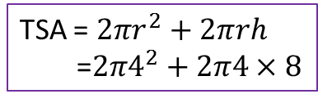
24
7
30
Date
Volume of a Prism
EQ – Describe how the formula for the area of a circle is used to find the volume of a cylinder?
TSA = $2πr^{2}+2πrh$
5cm
TSA = $2πr^{2}+2πrh$
=$2π5^{2}+2π5×6$
= 347.58${cm}^{2}$
6cm
TSA = $2πr^{2}+2πrh$
=$2π4^{2}+2π4×8$
8m
$$12m$$
19

Slide 22
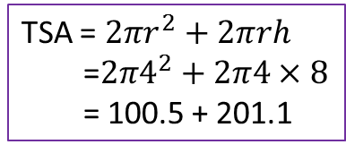
24
7
30
Date
Volume of a Prism
EQ – Describe how the formula for the area of a circle is used to find the volume of a cylinder?
TSA = $2πr^{2}+2πrh$
5cm
TSA = $2πr^{2}+2πrh$
=$2π5^{2}+2π5×6$
= 347.58${cm}^{2}$
6cm
TSA = $2πr^{2}+2πrh$
=$2π4^{2}+2π4×8$
= 100.5 + 201.1
8m
$$12m$$
19

Slide 23
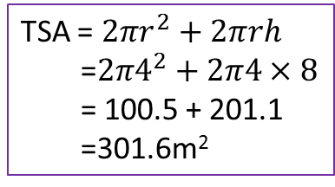
24
7
30
Date
Volume of a Prism
EQ – Describe how the formula for the area of a circle is used to find the volume of a cylinder?
TSA = $2πr^{2}+2πrh$
5cm
TSA = $2πr^{2}+2πrh$
=$2π5^{2}+2π5×6$
= 347.58${cm}^{2}$
6cm
TSA = $2πr^{2}+2πrh$
=$2π4^{2}+2π4×8$
= 100.5 + 201.1
=301.6m²
8m
$$12m$$
19

Slide 24
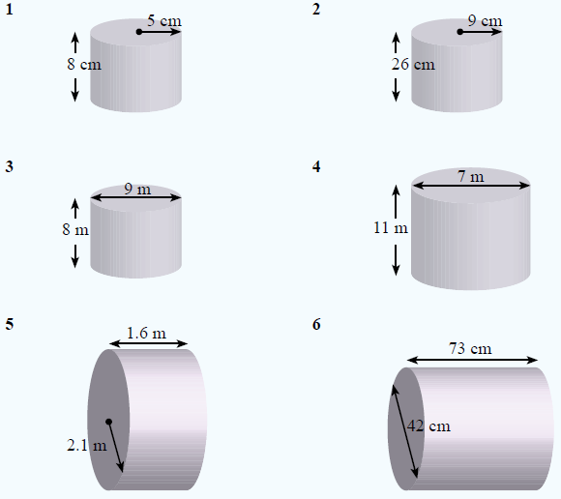
Complete exercise 3.8 on page 39.

Slide 25

Exit pass. Answer the following on a piece of paper and hand it in to your teacher.
Calculate the SA of the following cylinder.
18m
$$21m$$

